Slide 1

Go, change the world
RV College of
Engineering
Operating Systems (UNIT-3)

Slide 2
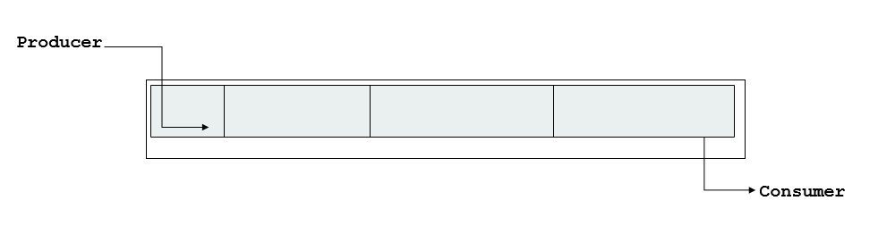
Process Synchronization
Cooperating processes : The Process that can affect or be affected by the other process executing in the system.
Cooperating Process : Share the data directly or they can be in the shared memory.
Concurrent access to shared data may result in data inconsistency
Maintaining data consistency requires mechanisms to ensure the orderly execution of cooperating processes
Concurrent access to the shared memory may result in Data Inconsistency ( If the two or more process try to access
the same data in the shared memory, there will be a problem- to address this issue we need Process Synchronization).
For Example
Bounded Buffer Problem also termed as the Producer Consumer Problem.
There is buffer of n slots, and each slot have capable of storing one unit of
Data.

Slide 3
Process Synchronization
We need to have the synchronization between producer and consumer i.e Consumer should not try to consume the data that has not yet produced.
Illustration of the problem: Suppose that we wanted to provide a solution to the consumer-producer problem that fills all the buffers. We can do so by having an integer counter that keeps track of the number of full buffers.
Initially, counter is set to 0.
It is incremented by the producer after it produces a new buffer and is decremented by the consumer after it consumes a buffer

Slide 4
Producer and Consumer Code
Producer Code.
while (true) { /* produce an item in next produced */
while (counter == BUFFER_SIZE) ;
/* do nothing */
buffer[in] = next_produced;
in = (in + 1) % BUFFER_SIZE;
counter++;
}
Consumer Code
while (true) {
while (counter == 0)
; /* do nothing */
next_consumed = buffer[out];
out = (out + 1) % BUFFER_SIZE;
counter--;
/* consume the item in next consumed */
}

Slide 5
Producer Consumer Problem
Let us assume the value of Counter is 5.
Now producer and consumer processes concurrently execute the statements “counter++” and “counter--”
The value of the counter may be 4, 5 or 6, 5….. Which is the correct value in this if there is a synchronization between process and consumer.
The only correct result, though, is counter == 5, which is generated correctly if the producer and consumer execute separately.
Do we really get the value of Counter = 5 if both producer and consumer execute concurrently.

Slide 6
Producer Consumer Problem
When the counter statement is executed at the machine level it will be executed as below.
Let us take the value of the counter = 5
“counter++” may be implemented in machine language.
register1 = counter = (register1 =5 & counter = 5)
register1 = register1 + 1 = (register1 =6 & counter = 5)
counter = register1 = counter = 6
First the value of counter will be stored in register, register will be incremented and then that will stored back to counter
Counter--” may be implemented in machine language.
register1 = counter = (register1 =5 & counter = 5)
register1 = register1 - 1 = (register1 =4& counter = 5)
counter = register1 = counter = 4

Slide 7
Race Condition
counter++ could be implemented as register1 = counter register1 = register1 + 1 counter = register1
counter-- could be implemented as register2 = counter register2 = register2 - 1 counter = register2
Consider this execution interleaving with “count = 5” initially:
S0: producer execute register1 = counter {register1 = 5} S1: producer execute register1 = register1 + 1 {register1 = 6} S2: consumer execute register2 = counter {register2 = 5} S3: consumer execute register2 = register2 – 1 {register2 = 4} S4: producer execute counter = register1 {counter = 6 } S5: consumer execute counter = register2 {counter = 4}
A situation like this, where several processes access and manipulate the same data concurrently and the outcome of the execution depends on the particular order in which the access takes place, is called a race condition

Slide 8
Critical Section
Consider system of n processes {p₀, p₁, … p_{n-1}}
Each Process have segment of code called Critical Section
Critical Section : Segment of the code of the process, in which the process will be changing the data in the shared region of the memory.
I.E whenever the process is accessing the shared memory and doing some changes, the code responsible for that is called Critical Section
Each process has critical section segment of code
Process may be changing common variables, updating table, writing file, etc.
When one process in critical section, no other may be in its critical section.
Critical section problem is to design protocol that the processes can use in order to be synchronized (Process should not change the shared data concurrently) .

Slide 9
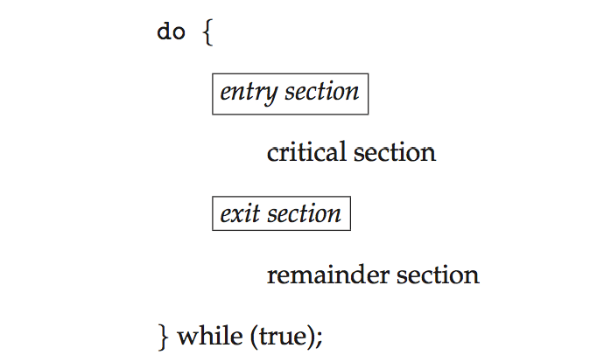
Critical Section
Rules to Operate in Critical Section
Each process must ask permission to enter critical section and the The section of code implementing this request is the entry section.
The critical section may be followed by an exit section.
The remaining code is the remainder section.
General structure of process P_{i}

Slide 10
Solution Critical Section - must satisfy the following threerequirements
1. Mutual Exclusion - If process P_{i} is executing in its critical section, then no other processes can be executing in their critical sections
2.Progress – If no process is executing in its critical section and some processes wish to enter their critical sections, then only those processes that are not executing in their remainder sections can participate in deciding which will enter its critical section next, and this selection cannot be postponed indefinitely.
3. Bounded Waiting - There exists a bound, or limit, on the number of times that other processes are allowed to enter their critical sections after a process has made a request to enter its critical section and before that request is granted.
If Bounded waiting is not there it will lead to the Starvation

Slide 11
Two approaches depending on if kernel is preemptive or non- preemptive
Preemptive – allows preemption of process when running in kernel mode
Non-preemptive – runs until exits kernel mode, blocks, or voluntarily yields CPU
Essentially free of race conditions in kernel mode

Slide 12
Two approaches depending on if kernel is preemptive or non- preemptive
Preemptive – allows preemption of process when running in kernel mode
Non-preemptive – runs until exits kernel mode, blocks, or voluntarily yields CPU
Essentially free of race conditions in kernel mode

Slide 13
Peterson’s Solution
Software based solution for Critical Section problem.
It illustrates some of the complexities involved in designing software that addresses the requirements of mutual exclusion, progress, and bounded waiting.
Peterson’s solution is restricted to two processes that alternate execution
between their critical sections and remainder sections. Lets say P_{i} and P_{j}
Peterson’s solution requires the two processes to share two data items:
int turn;
boolean flag[2];
The variable turn indicates whose turn it is to enter its critical section. That is,if turn == i, then process Pi is allowed to execute in its critical section.
Theflag array is used to indicate if a process is ready to enter its critical section. For example, if flag[i] is true, this value indicates that Pi is ready to enterits critical section.

Slide 14
Peterson’s Solution- Algorithm
do {
flag[i] = true; # Process i is ready to enter the critical section
turn = j; # But if the other process wishes to enter the critical section, it can do so
while (flag[j] && turn = = j);#(If this condition is true means it will remain in while loop only)
#We have semicolon, if the condition is true Pi will stay in while loop only.
critical section
flag[i] = false;
remainder section
} while (true);
do {
flag[j] = true; # Process j is ready to enter the critical section
turn = i; # But if the other process wishes to enter the critical section, it can do so
while (flag[i] && turn = = i);
critical section
flag[j] = false;
remainder section
} while (true);
The structure of process Pi in Peterson’s solution
The structure of process Pj in Peterson’s solution

Slide 15
Peterson’s Solution
We now prove that this solution is correct. We need to show that:
1. Mutual exclusion is preserved.
Pi will enter into crticial section only if one among these is falls(flag[j] && turn = = j) and if one among these are falls pj will not be able to enter
2. The progress requirement is satisfied.
Pi and Pj were not in reminder section and one among them took the decision of who will enter into section.
3. The bounded-waiting requirement is met
There is no indefinite wait as soon as one process enters critical section, the other process is also allowed.

Slide 16
Synchronization Hardware
Software-based solutions such as Peterson’s are not guaranteed to work on modern computer architectures.
All the hardware solutions below based on idea of locking
Protecting critical regions via locks
test_and_set Instruction
Hardware solution for synchronization problem
It takes two values 0 and 1.
0 means unlock and 1 means lock.
Process will enquire about lock before entering into critical section.
If the Lock value is 1 means it will wait for the lock to become zero.
If the Lock value is 0 means it will set the lock and enter into critical section

Slide 17
test_and_set Instruction
Definition:
boolean test_and_set (boolean *target)
{
boolean rv = *target;
*target = TRUE;
return rv:
}
It has Boolean return type i.e : It returns only true or false
It takes the Boolean variable (Target and rv)
Target is shared lock variable that takes the value 0 and 1.
It will be assigned to rv and that will be returned.
Atomic Operation : The whole process of test and set will happen in single machine cycle.

Slide 18
test_and_set Instruction
boolean test_and_set (boolean *target) { boolean rv = *target; *target = TRUE; return rv: }
1. Initially the lock is always set to zero.
2. test and set (&lock) will call the Boolean function test and set
3. Lock value is target value
4. rv = 0 and it will be returned
5. target is again set back to true and 0 will be returned
5. while(0) – Condition become false and the loop is broke and process will enter the critical section
6. So 0 implies that the critical section is unlocked
7. When the process is in Critical section, remember the target value was set to 1 in setp5
8. Now if again some process comes it will be while (1)– So it will wait
9. Now when the process comes out of critical section lock is set to false and now while becomes 0, so now the other process will get a chance to enter
Solution:
do { while (test_and_set(&lock))
; /* do nothing */
/* critical section */
lock = false;
/* remainder section */
} while (true);

Slide 19
Compare and Swap Instruction
Defn of Swap Instruction : void swap (boolean*a, boolean*b)
{boolean temp
temp = *a
*a = *b
*b = temp }
Code for Mutual Exclusion
do{ key = true
while (key ==true);
swap(&lock,&key)
# Critical section
lock = false
}while(True)
1. Initially the lock is always set to zero.
2. Each process have key values
3. Key is set to true
4.After swapping key becomes false(b) and lock becomes true(a)
5.It comes to the while loop and now key is false , so the condition fails, hence it enters the critical section
6.Once the process comes out of the critical section it will make lock as zero, so other process can come.
7.Both Test and set and compare and swap provide the Mutual Exclusion but not Bounded waiting

Slide 20
Mutex Locks
It takes two values 0 and 1.
0 means unlock and 1 means lock.
If it is zero means, process can acquire the lock and change the value of lock to 1 and enter to critical section.
Once the process is finished executing in the critical section it will release the lock.
do {
acquire lock
critical section
release lock
remainder section
} while (true);

Slide 21
Mutex Locks
The Boolean variable acquire is shared between the process and initially it is zero
acquire() { while (lock! = 0)
; /* busy wait */
available = false;
}
release() {
available = true;
}

Slide 22
Semaphores
Semaphore is integer variable which is non negative and shared between the variables (Resource) .
Semaphore S – integer variable
Can only be accessed via two indivisible operations
wait() and signal()
Originally called P() and V()
Definition of the wait() operation
wait(S) {
while (S <= 0)
; // busy wait
S--;
} (It will check S is less than or equal to Zero, it will stay in while loop, but if S becomes greater than Zero, it will break the loop and decrement the S)
It tells the process that, whether the resource(S) is available, if it is not available it will wait, if it is available that resource will be taken by the process and it will decrement one resource value.

Slide 23
Semaphores
Definition of the signal() operation
signal(S) {
S++;
}
Once the process is completed using the resource, it will return back the resource, hence the S is incremented.
Wait and Signal Operations are executed indivisibly(If the one process modifies the semaphores value, no other process can simultaneously modify that semaphore value

Slide 24
Types of Semaphores
Binary Semaphore : The value of the binary semaphore can range between 0 and 1. They are also called as mutex locks, as they are the locks that provide the Mutex exclusion.
(If the value is 0, it means some process is already using the resource, if the value is 1, the resource is available for the process to use.)
Counting Semaphore : Its value can range over an unrestricted domain, it is used to control the access to resources, that have multiple instances.
Lets assume that we have three process P1,P2,P3 and there is resource with two instances ( means that resource can be used by two process at the same time)
wait(S) {
while (S >= 0)
; // busy wait
S--;
S is set to 2, after first loop, it will become S=1, P1 take the process, after second loop P2 take the process, at third iteration, S will be zero, P3 will wait.

Slide 25
Classical Problems of Synchronization
Classical problems used to test newly-proposed synchronization schemes
Bounded-Buffer Problem
Readers and Writers Problem
Dining-Philosophers Problem

Slide 26
Bounded Buffer Problem
Bounded Buffer Problem also termed as the Producer Consumer Problem.
There is buffer of n slots, and each slot have capable of storing one unit of
Data.
There are the two process
Producer : Produce the Data and Store in the Buffer
Consumer : Remove the data from the Buffer
Rules:
Producer must not insert the data when the Buffer is full.
Consumer should not retrieve the data when the Buffer is empty.
Producer and Consumer should not insert and remove the data simultaneously.

Slide 27
Solution using Semaphore
We will make use of 3 Semaphores
1. Binary Semaphore (Mutex) : Used to acquire and release Lock
2. Empty Semaphore : Counting Semaphore, whose initial value is number of free slots in the buffer, since initially the buffer is empty its value is equal the number of slots in the buffer
3.Full Semaphore : Counting Semaphore, whose initial value is Zero
(It is used to track how many number of slots are full, basically it will keep track of filled slots in the buffer)

Slide 28
Solution using Semaphore
We will make use of 3 Semaphores
1. Binary Semaphore (Mutex) : Used to acquire and release Lock
2. Empty Semaphore : Counting Semaphore, whose initial value is number of free slots in the buffer, since initially the buffer is empty its value is equal the number of slots in the buffer
3.Full Semaphore : Counting Semaphore, whose initial value is Zero
(It is used to track how many number of slots are full, basically it will keep track of filled slots in the buffer)

Slide 29
Producer and Consumer Code
Producer Code
do
{
wait(empty); #wait until
empty is > 0 and decrement empty
wait (mutex);acquire lock
#adding of data happen
signal(mutex); release lock
signal (Full);Increment Full
}while (True)
Consumer Code
do
{
wait(full); #wait until
full is > 0 and decrement
wait (mutex);acquire lock
#adding of data happen
signal(empty); release lock
signal (empty);Increment Full
}while (True)

Slide 30
Important methods that can be used with semaphore in c
Some sem_init -> Initialise the semaphore to some initial value
sem_wait -> Same as wait() operation
sem_post -> Same as Signal() operation
sem_destroy -> Destroy the semaphore to avoid memory leak
One can use include header file and declare a mutex of type pthread_mutex_t in c.
Some important methods that can be used with semaphore in c
pthread_mutex_init -> Initialise the mutex
pthread_mutex_lock() -> Same as wait() operation
pthread_mutex_unlock() -> Same as Signal() operation
pthread_mutex_destroy() -> Destroy the mutex to avoid memory leak

Slide 31
Important methods that can be used with semaphore in c
pthread_mutex_init -> Initialise the mutex #This initializes *mutex with the attributes specified by attr. If attr is NULL, a default set of attributes is used. The initial state of *mutex will be "initialized and unlocked".
sem_init : This initializes the semaphore *sem. The initial value of the semaphore will be value. If pshared is 0, the semaphore is shared among all threads of a process (and hence need to be visible to all of them such as a global variable). If pshared is not zero, the semaphore is shared but should be in shared memory
int sem_init(sem_t * sem, int pshared, unsigned int value)
pthread_mutex_lock() -> Same as wait() operation
pthread_mutex_unlock() -> Same as Signal() operation
pthread_mutex_destroy() -> Destroy the mutex to avoid memory leak

Slide 32
Producer Code
Producer Code
do
{
wait(empty); #wait until
empty is > 0 and decrement empty
wait (mutex);acquire lock
#adding of data happen
signal(mutex); release lock
signal (Full);Increment Full
}while (True)
Producer Code
int waittime,item,i;
item=rand()%5;
waittime=rand()%5;
sem_wait(&empty);
pthread_mutex_lock(&mutex);
printf("\nProducer has produced item: %d\n",item);
write(item);
pthread_mutex_unlock(&mutex);
sem_post(&full);

Slide 33
Producer and Consumer Code
Producer Code
do
{
wait(empty); #wait until
empty is > 0 and decrement empty
wait (mutex);acquire lock
#adding of data happen
signal(mutex); release lock
signal (Full);Increment Full
}while (True)
Consumer Code
do
{
wait(full); #wait until
full is > 0 and decrement empty
wait (mutex);acquire lock
#adding of data happen
signal(empty); release lock
signal (empty);Increment Full
}while (True)

Slide 34
Reader Writer Problem
A database is shared between the concurrent process
Some of these process may want to only read and some may want to update(Read and Write)
Those Process who wants to only read - Readers
Those process who wants to Read and Write – Writers
If the two readers access the data at same time then there will be no problem
But if two writers want to access the data at same time then there may be chaos
To Solve this we should make sure that – Writers get the exclusive access to the shared database system

Slide 35
Reader Writer Problem
To Solve this we will use two semaphores and 1 Integer
Mutex : (Semaphore) Initialised to 1 – Which is used to maintain the mutual exclusion, when the read count variable is updated i.e when any reader enter and exit from the database
Wrt(Semaphore) - : Initialised to 1 – common to both reader and writer process and which is used to write.
Read count (Variable ) – Initialised to 0 – Keeps track of how many process are reading the data

Slide 36
Reader and Writer Code
Writer Code
do
{
#Writer request for the access
wait(wrt); - #Performs the write and during this time no reader or writer will be allowed
#Performs the write operation
Signal(wrt);
}while (True)

Slide 37
.
Reader Code
do
{
wait(mutex); #wait until
readcount++ // The number of readers are increase by 1
if(readcount ==1) // If I have at least one reader, we should not allow the writers to come , so this will be achieved by calling wrt
Wait(wrt)
Signal(mutex) // other readers can enter while one reader is in the data system
## Perform the Read operation
## Now read wants to leave
Wait(mutex)
Readcount--
if(readcount ==0) // If I don’t have any readers, writer can come
signal(wrt) #
Signal(mutex) // It will free the mutex

Slide 38
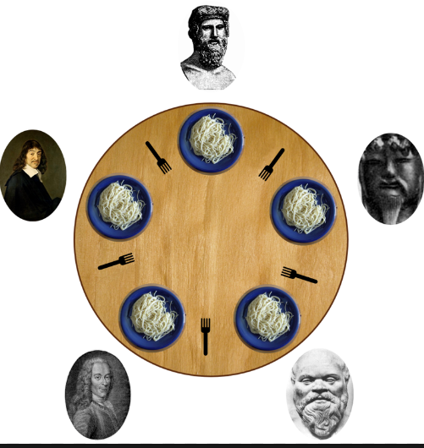
.
Dining Philosopher Problem
do {
.
takefork(i)
takefork(i+1%N))
Eat();
putfork(i)
Putfork((i+1)%N))
Philosophers spend their lives alternating thinking and eating
Don’t interact with their neighbors, occasionally try to pick up 2 chopsticks (one at a time) to eat from bowl
Need both to eat, then release both when done
In the case of 5 philosophers
Shared data
Bowl of rice (data set)
Semaphore chopstick [5] initialized to 1

Slide 39
.
Dining Philosopher Problem- Some General Solutions
Deadlock handling
Allow at most 4 philosophers to be sitting simultaneously at the table.
Allow a philosopher to pick up the forks only if both are available (picking must be done in a critical section.
Use an asymmetric solution -- an odd-numbered philosopher picks up first the left chopstick and then the right chopstick. Even-numbered philosopher picks up first the right chopstick and then the left chopstick.

Slide 40
.
Dining Philosopher Problem – Solution using Semaphore
We will take 5 Semaphores and all are initialised to 1
do {
.
wait (takefork(Si))
wait(takefork(Si+1%N))
Eat();
signal(putfork(Si))
Signal(putfork((Si+1)%N))
}
while(true

Slide 41
Deadlock and Starvation(Drawbacks of Semaphores
Deadlock – two or more processes are waiting indefinitely for an event that can be caused by only one of the waiting processes
Let S and Q be two semaphores initialized to 1
P₀ P₁
wait(S); wait(Q);
wait(Q); wait(S);
... ...
signal(S); signal(Q);
signal(Q); signal(S);
Starvation – indefinite blocking
A process may never be removed from the semaphore queue in which it is suspended
Priority Inversion – Scheduling problem when lower-priority process holds a lock needed by higher-priority process
Solved via priority-inheritance protocol

